Slide 1
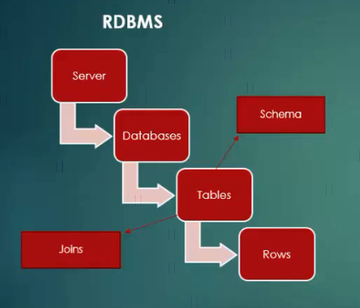
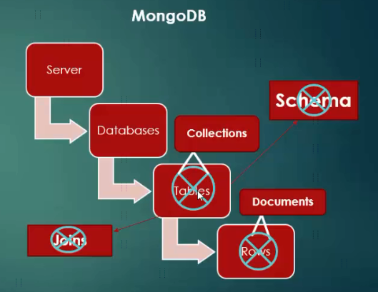
Difference between RDBMS & MongoDB

Slide 2
NoSQL(Not Only SQL) Database
E:\udemy\Learn MongoDB Leading NoSQL Database from scratch\[Tutsgalaxy.com] - Learn MongoDB Leading NoSQL Database from scratch\02 Introduction to NoSQL Database

